Slide 1





A Project of Financial Accounting and Control (2023-2025)
Atharva Sahasrabuddhe – 09
Dhruvi Ambekar – 17
Kalyani Kurkure - 26
Mayuri Mahesh Dike- 36
Rakshita Shrivastava – 47
Shikha Hardiha – 56
Vaishnavi Pramod Bhamre - 64
Inter Company Analysis Of
Oil And Gas Industry
Guided by : Prof. Krunal Damania

Slide 2
I N T R O D U C T I O N O F O I L A N D G A S I N D U S T R Y
The oil and gas sector is among the eight core industries in India and plays a major role in influencing the decision-making for all the other important sections of the economy.
India’s economic growth is closely related to its energy demand, therefore, the need for oil and gas is projected to increase. India retained its spot as the third-largest consumer of oil in the world as of 2022.
Government has allowed 100% foreign direct investment (FDI) in many segments of the sector, including natural gas, petroleum products and refineries, among others. The FDI limit for public sector refining projects has been raised to 49% without any disinvestment or dilution of domestic equity in existing PSUs. Today, it attracts both domestic and foreign investment. India’s crude oil production in FY23 stood at 29.2 MMT.
India is the third-largest energy and oil consumer in the world. The country's oil demand is expected to increase by 40% to 6.7 mb/day by 2030 and further to 8.3 mb/day in 2050.

Slide 3
S E C T O R A L A N A L Y S I S
The industry is often divided into three segments: upstream, the business of oil and gas exploration and production; midstream, transportation and storage; and. downstream, which includes refining and marketing.
The market was negatively impacted by the outbreak of COVID-19 due to regional lockdowns and a decline in demand for refined petroleum products. Currently, the market has rebounded to pre-pandemic levels.
Factors such as the increasing natural gas pipeline capacity and the increasing demand for petroleum products are expected to drive the Indian oil and gas market. Also, the oil and natural gas market is a major industry in the energy market.
A huge dependence on imports of crude oil and natural gas to satisfy domestic demand and the high volatility of crude oil prices may hinder the growth of the Indian oil and gas market.
Production of oil is mostly dominated by the two public sector companies, ONGC and Oil India Limited.

Slide 4

PETRONET LNG
I N T R O D U C T I O N O F C O M P A N Y
Petronet LNG limited is an Indian Oil and Gas company formed by the Government of India to import liquified natural gas (LNG) and set up LNG terminals in the country.
It is a joint venture company promoted by GAIL Ltd., ONGC Ltd., IOC Ltd and BPCL. Each of them holds 12.5% stake in the company and rest 50% is for public and FIIs.
PLL is engaged in the import, storage and regasification of LNG. It fulfils around 40% of the nation’s gas supplies and 2/3rd of the total LNG imports in the country.
It has two terminals, one at Dahej in Gujarat (capacity - 17.5 MMTPA) and the other in Kochi, Kerala (capacity - 5 MMTPA).

Slide 5
PETRONET LNG
A C T U A L VS F O R E C A S T S

Slide 6
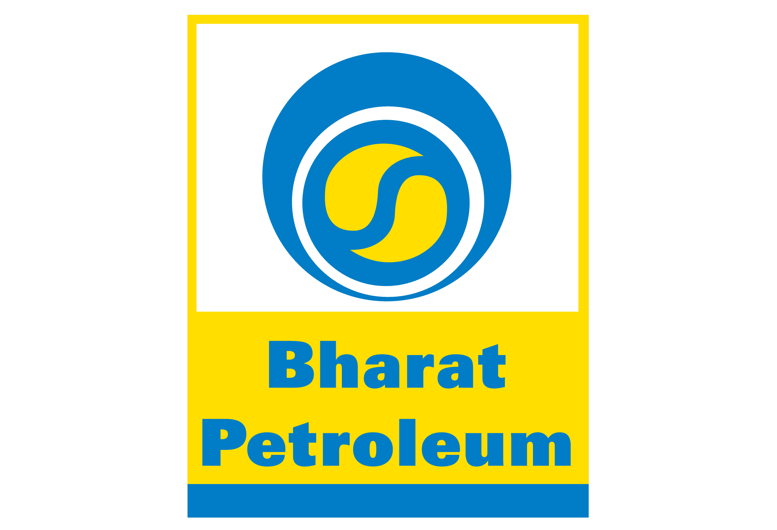
BHARAT PETROLEUM CORPORATION LIMITED (BPCL)
I N T R O D U C T I O N O F C O M P A N Y
Bharat Petroleum Corporation Limited (BPCL) is an Indian public sector undertaking (PSU) under the ownership of the Ministry of Petroleum and Natural Gas, Government of India.
It operates three refineries in Bina, Kochi and Mumbai. BPCL is India's second-largest government-owned downstream oil producer, whose operations are overseen by the Ministry of Petroleum and Natural Gas.
It carries out production of oil and natural gas, refining of crude oil and marketing and distribution of petroleum products. The company also focuses on renewable energy.
BPCL markets products through a network of retail outlets, dealers, and distributors. The company also provides fuel to domestic and international airlines. It has refineries in Maharashtra, Kerala, Assam and Madhya Pradesh in India. The company markets its products under various brands, including MAK, Speed, and Bharatgas.

Slide 7
BHARAT PETROLEUM CORPORATION LIMITED (BPCL)
A C T U A L VS F O R E C A S T S

Slide 8
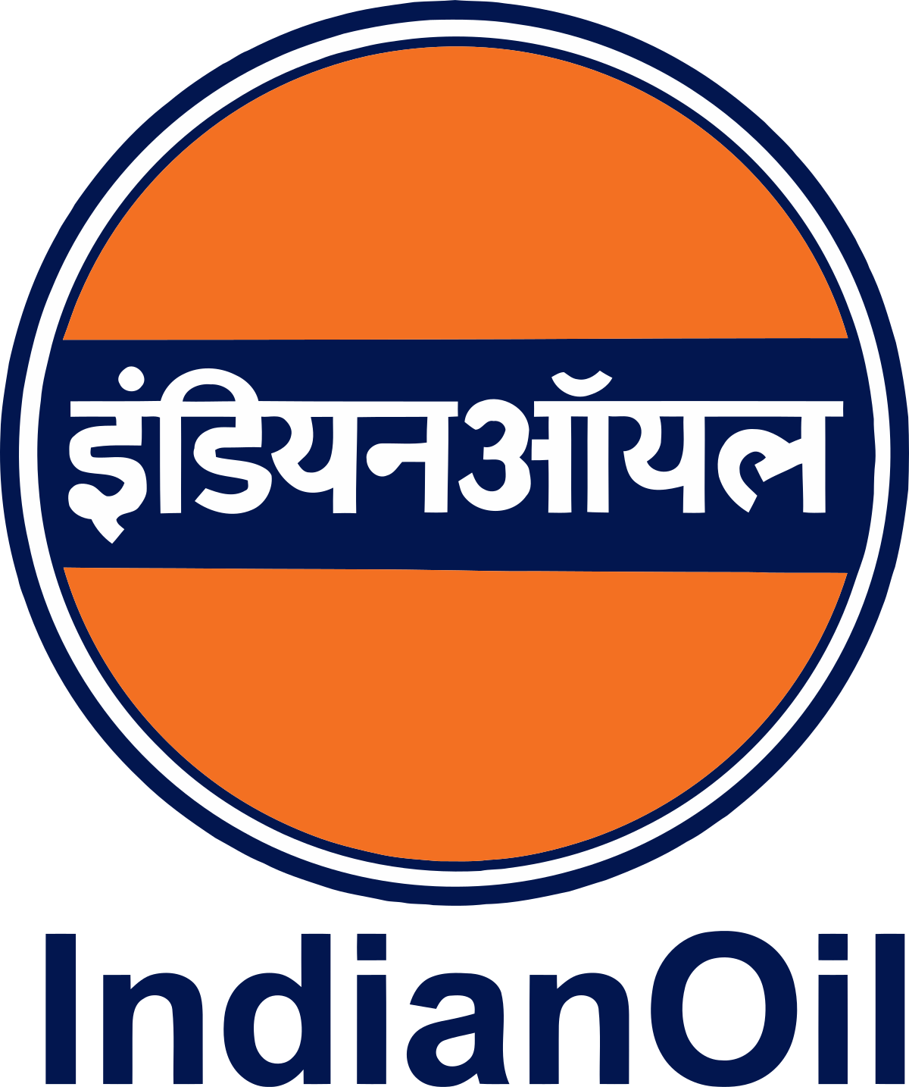
INDIAN OIL CORPORATION LIMITED (IOCL)
I N T R O D U C T I O N O F C O M P A N Y
IOCL is a public-sector enterprise with the Government of India holding a majority stake in the company. IOCL is India’s largest Government-owned oil company with its products and services catalogue including exploration and production of petrochemicals, crude oil, and natural gas.
Deals in extracting oil, refining it, transporting it via pipelines, and marketing petrochemical products.
Operates 11 of the 23 refineries in India and has a combined refining capacity of 80.7 million tonnes in a year.
Operates in Sri Lanka, Mauritius, and the Middle East via its subsidiaries.

Slide 9
INDIAN OIL CORPORATION LIMITED (IOCL)
A C T U A L VS F O R E C A S T S

Slide 10
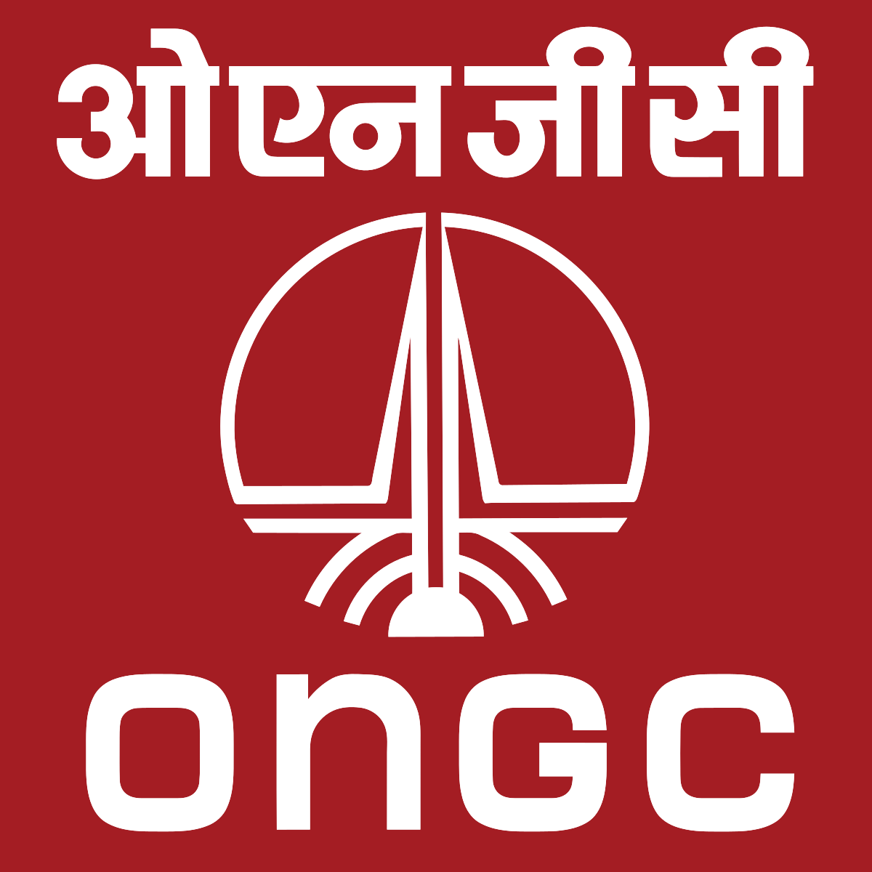
OIL AND NATURAL GAS CORPORATION (ONGC)
I N T R O D U C T I O N O F C O M P A N Y
The Oil and Natural Gas Corporation Limited (ONGC) is an Indian central public sector undertaking under the ownership of Ministry of Petroleum and Natural Gas, Government of India.
It is the largest government-owned-oil and gas explorer and producer in the country and produces around 70% of India's domestic production of crude oil and around 84% of natural gas. ONGC's operations include conventional exploration and production, refining and progressive development of alternate energy sources like coal-bed methane and shale gas.
Maharatna ONGC is the largest crude oil and natural gas Company in India, contributing around 71% to Indian domestic production. Crude oil is the raw material used by downstream companies like IOC, BPCL, HPCL and MRPL (Last two are subsidiaries of ONGC) to produce petroleum products like Petrol, Diesel, Kerosene, Naphtha, and Cooking Gas LPG.
This Photo by Unknown Author is licensed under CC BY-SA

Slide 11
OIL AND NATURAL GAS CORPORATION (ONGC)
A C T U A L VS F O R E C A S T S
This Photo by Unknown Author is licensed under CC BY-SA

Slide 12

HINDUSTAN PETROLEUM CORPORATION LIMITED (HPCL)
I N T R O D U C T I O N O F C O M P A N Y
Hindustan Petroleum Corporation Limited (HPCL) is a subsidiary of Oil and Natural Gas Corporation (ONGC) which is in turn under the ownership of the Ministry of Petroleum and Natural Gas, Government of India. On 24 October 2019, it became a Maharatna (PSU).
HPCL was established in 1974 as a wholly-owned subsidiary of the Oil and Natural Gas Corporation (ONGC). It was incorporated under the Indian Companies Act 1913 and nationalized in 1974. HPCL was a government-owned company until the government of India sold a majority stake in the company to Oil and Natural Gas Corporation (ONGC) in 2017. ONGC currently holds a majority stake in HPCL. HPCL is primarily engaged in the downstream sector of the oil and gas industry. It operates in various segments, including refining, marketing, and distribution of petroleum and petroleum-related products.
HPCL sells various petroleum products such as petrol, diesel, LPG, aviation turbine fuel, lubricants, and more. It has ventured into areas such as petrochemicals and natural gas exploration and production.

Slide 13
HINDUSTAN PETROLEUM CORPORATION LIMITED (HPCL)
A C T U A L VS F O R E C A S T S

Slide 14

F I N A N C I A L R A T I O S A N A L Y S I S

Slide 16
R A N K I N G S
On the basis of some significant financial ratios we have ranked the five companies. The rankings are:
Petronet – 1st
ONGC – 2nd
IOCL – 3rd
BPCL- 4th
HP- 5th

Slide 17
C O N C L U S I O N
The oil and gas industry is undergoing significant changes driven by technological advancements, shifts toward renewable energy, and the importance of sustainability and environmental, social, and governance metrics in financial analysis.
The industry, a significant segment of the energy sector, has seen numerous fluctuations due to various factors, including geopolitical events, technological advancements, regulatory changes, and, most recently, the COVID-19 pandemic.
As of 2023, the oil and gas industry’s market valuation stands tall, despite the environmental concerns and the transition towards renewable energy sources. Hundreds of oil and gas companies are operating worldwide, each contributing to the extraction of this valuable resource. The industry’s profitability has traditionally depended on exploration costs, production costs, and average prices for oil and gas, which have varied over the years.
In conclusion, the oil and gas industry’s financial performance is influenced by many factors, from exploration and production costs to average oil and gas prices. As the industry navigates the transition toward a more sustainable future, it will be interesting to see how these factors evolve and impact the industry’s financial landscape.

